Slide 1
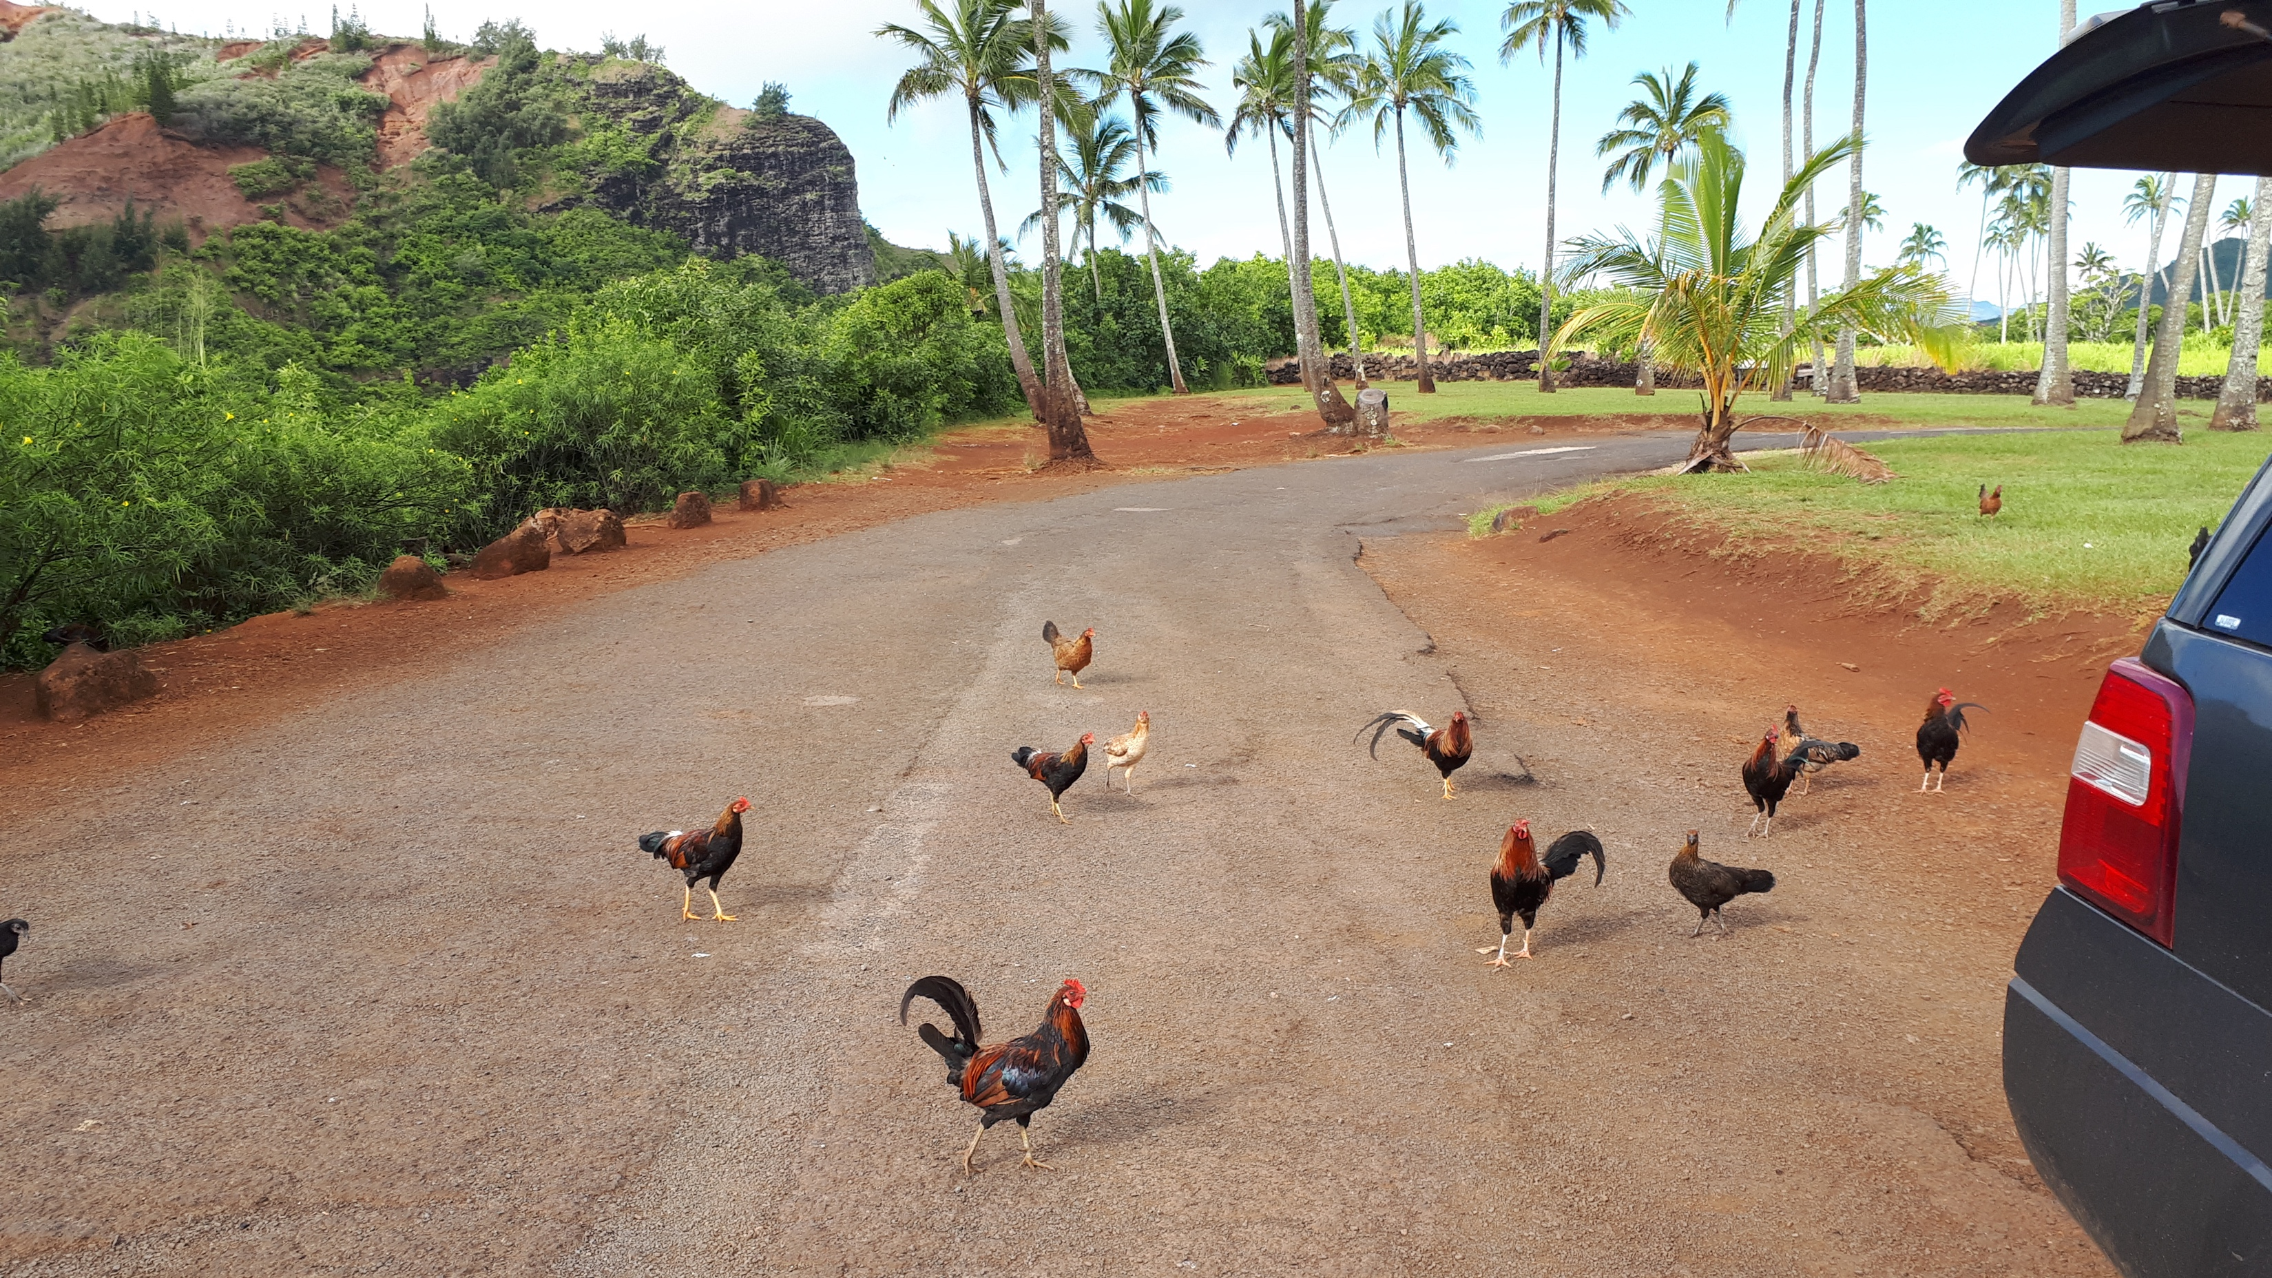

Slide 2
It’s about what kind of knowledge we want
Martin Johnsson, Department of Animal Breeding and Genetics, Swedish University of Agricultural Sciences
Notes:
Animal geneticist, what I do
Start that we have some common understanding of what open science is
And that by and large it’s a good thing
Then I will talk about some problems for open science, and how we understand and talk about it

Slide 3
Openness is not just synonymous with good science because openness means different things, good science has different values, and there are conflicts about what kind of science we want.

Slide 4
“What kind of science do we want?”
“What can I do right now?”
Notes:
I'm not a strategist, I don't write policy
I'm a researcher, and occasionally an evaluator of research (the peer in peer review)

Slide 5
Reproducibility
Replicability
Replication
Reform
Open access
Open data
Open source
Open peer review
“Open” as marketing

Slide 6
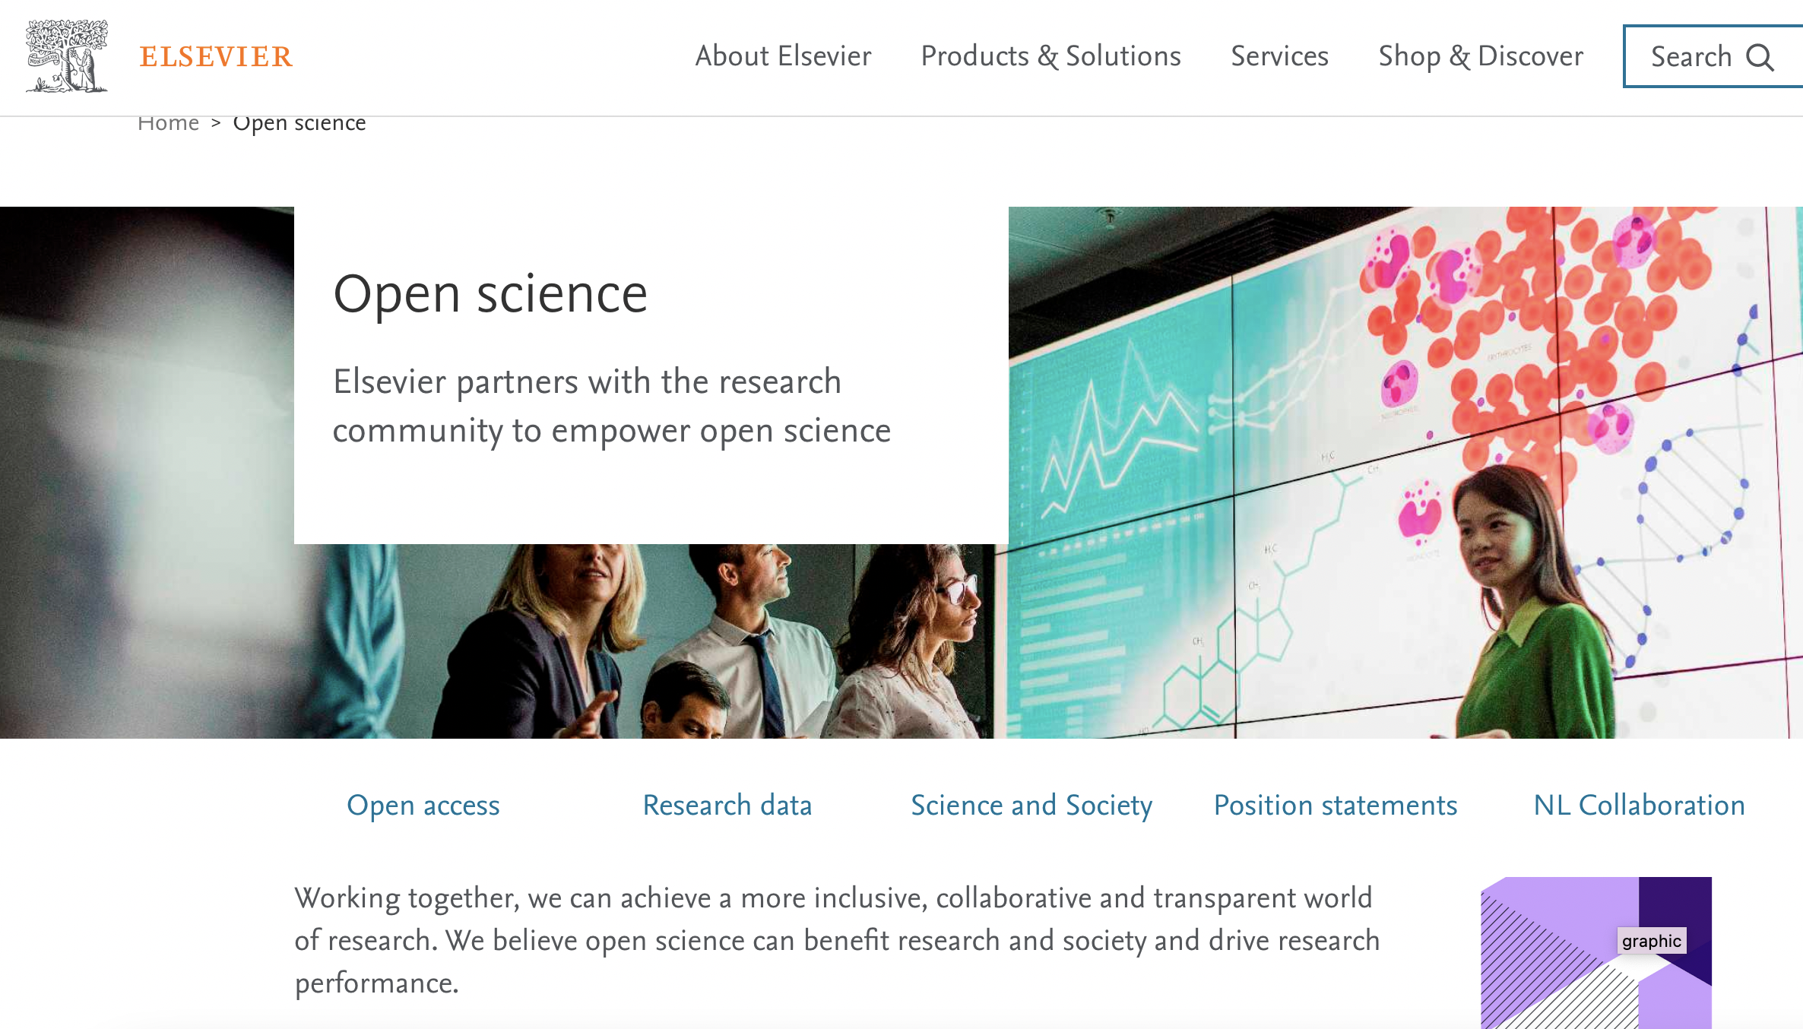

Slide 8
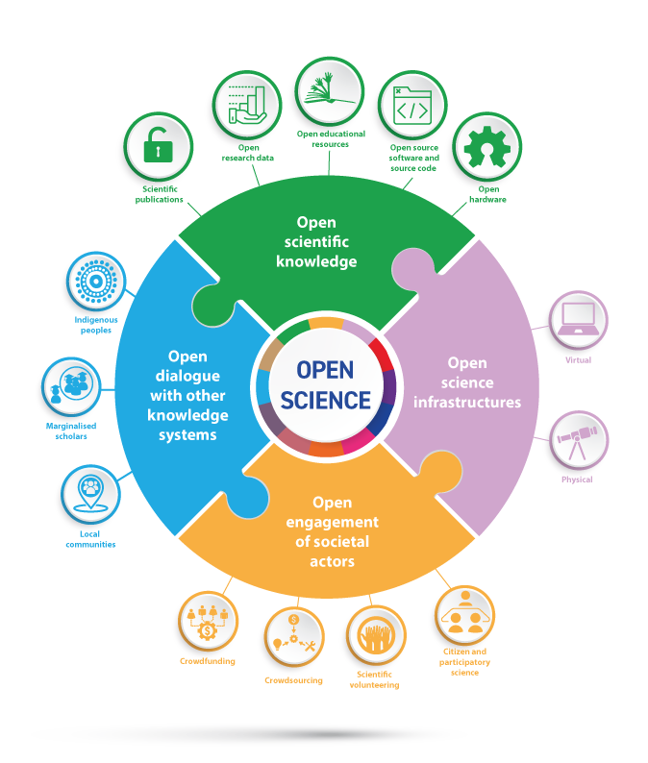
UNESCO pillars of open science (2021)
Collective learning process

Slide 9
Open as transparent
Open as open to experience
Reproducibility
Theory development
Technology
Equity
Notes:
Gustav Nilsonne argued after his talk that he didn't know about a field that had a replication crisis that got solved by theory. I would argue that I don't know about a field that had a replication crisis that got solved by open data (or anything else suggested by open science advocates except maybe preregistration of clinical trials, and I don't know if it solved it).

Slide 10
“If you can’t reproduce a result, it isn’t science.“
Statistical reproducibility of true and false results varies with model assumptions
(Devezer et al. 2021)

Slide 11
Almost no-one can reproduce anything
CERN
a large-scale genomic result
the 1918 flu pandemic

Slide 12

“Unless peer review is transparent there is no logical reason for the public to trust science.”

Slide 13
I can buy a computer for 100,000 SEK on a grant, pay deprecation over 5 years and process a lot of data on it. I can’t pay for long term storage and dissemination of the full dataset.
Notes:
* do something smaller that fits on an open repository
* don't do fully open data
Potential answers:
Tough luck guy, that is the cost of doing science -- big project are for big boys who can afford to do them right. But of course the same argument applies regardless of what the size of the "too-big" dataset is, as long as it is bigger than the one that be distributed.
* No one will look at all the data anyways -- if they want to, you can arrange that on an ad hoc basis -- doing the science is more important.
* The value of fully open data is so great in itself that the smaller option with fully open data is more valuable.

Slide 14
Non-open data:
secret (industry collaborations)
sensitive (about people)
dodgy (machine learning)

Slide 15
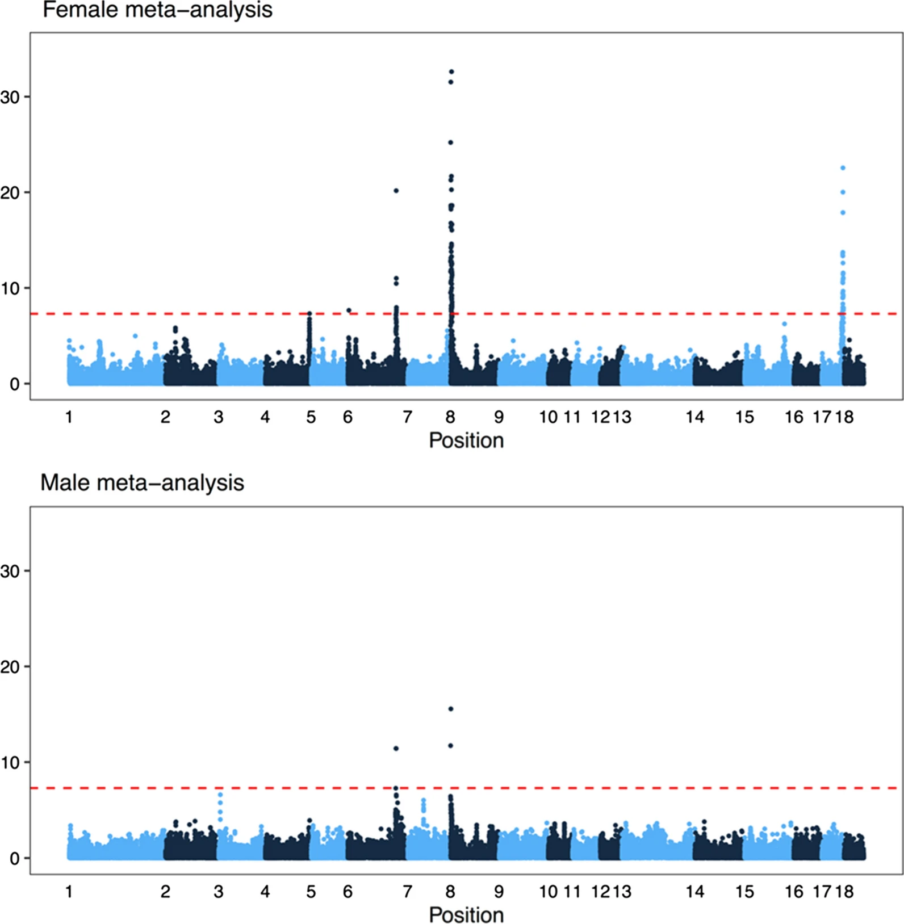
Genetic analysis of recombination rate based on ~150,000 pigs
(Johnsson et al. 2021)

Slide 16
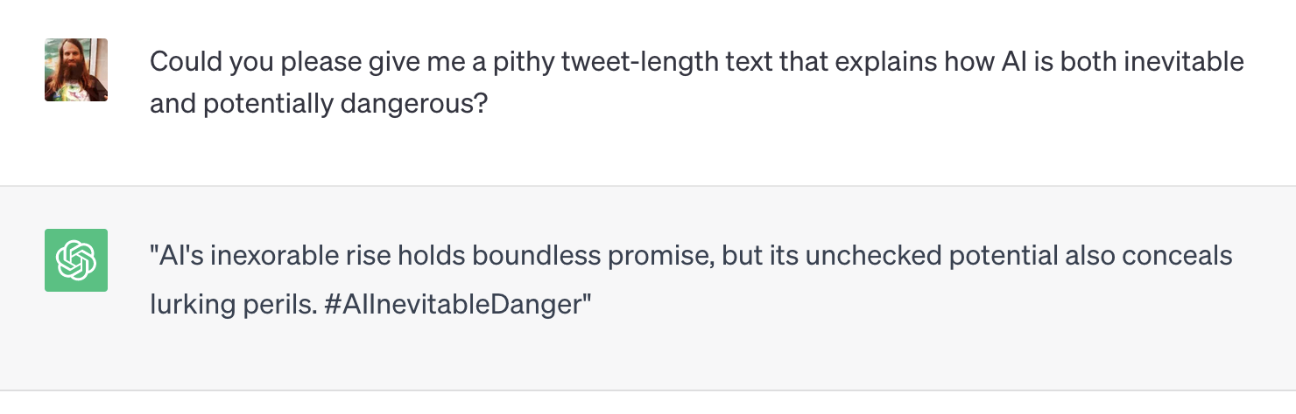

Slide 17
“We faced a significant number of hardware failures in our compute cluster while training OPT-175B. In total, hardware failures contributed to at least 35 manual restarts and the cycling of over 100 hosts over the course of 2 months. During manual restarts, the training run was paused, and a series of diagnostics tests were conducted to detect problematic nodes. Flagged nodes were then cordoned off and training was resumed from the last saved checkpoint. Given the difference between the number of hosts cycled out and the number of manual restarts, we estimate 70+ automatic restarts due to hardware failures.” (Zhang et al. 2022)

Slide 18
“To take one example, training the language generator GPT-3 is estimated to have cost OpenAI $10 to $12 million—and that’s just the final model, not including the cost of developing and training its prototypes.” (Technology Review 2020)

Slide 19
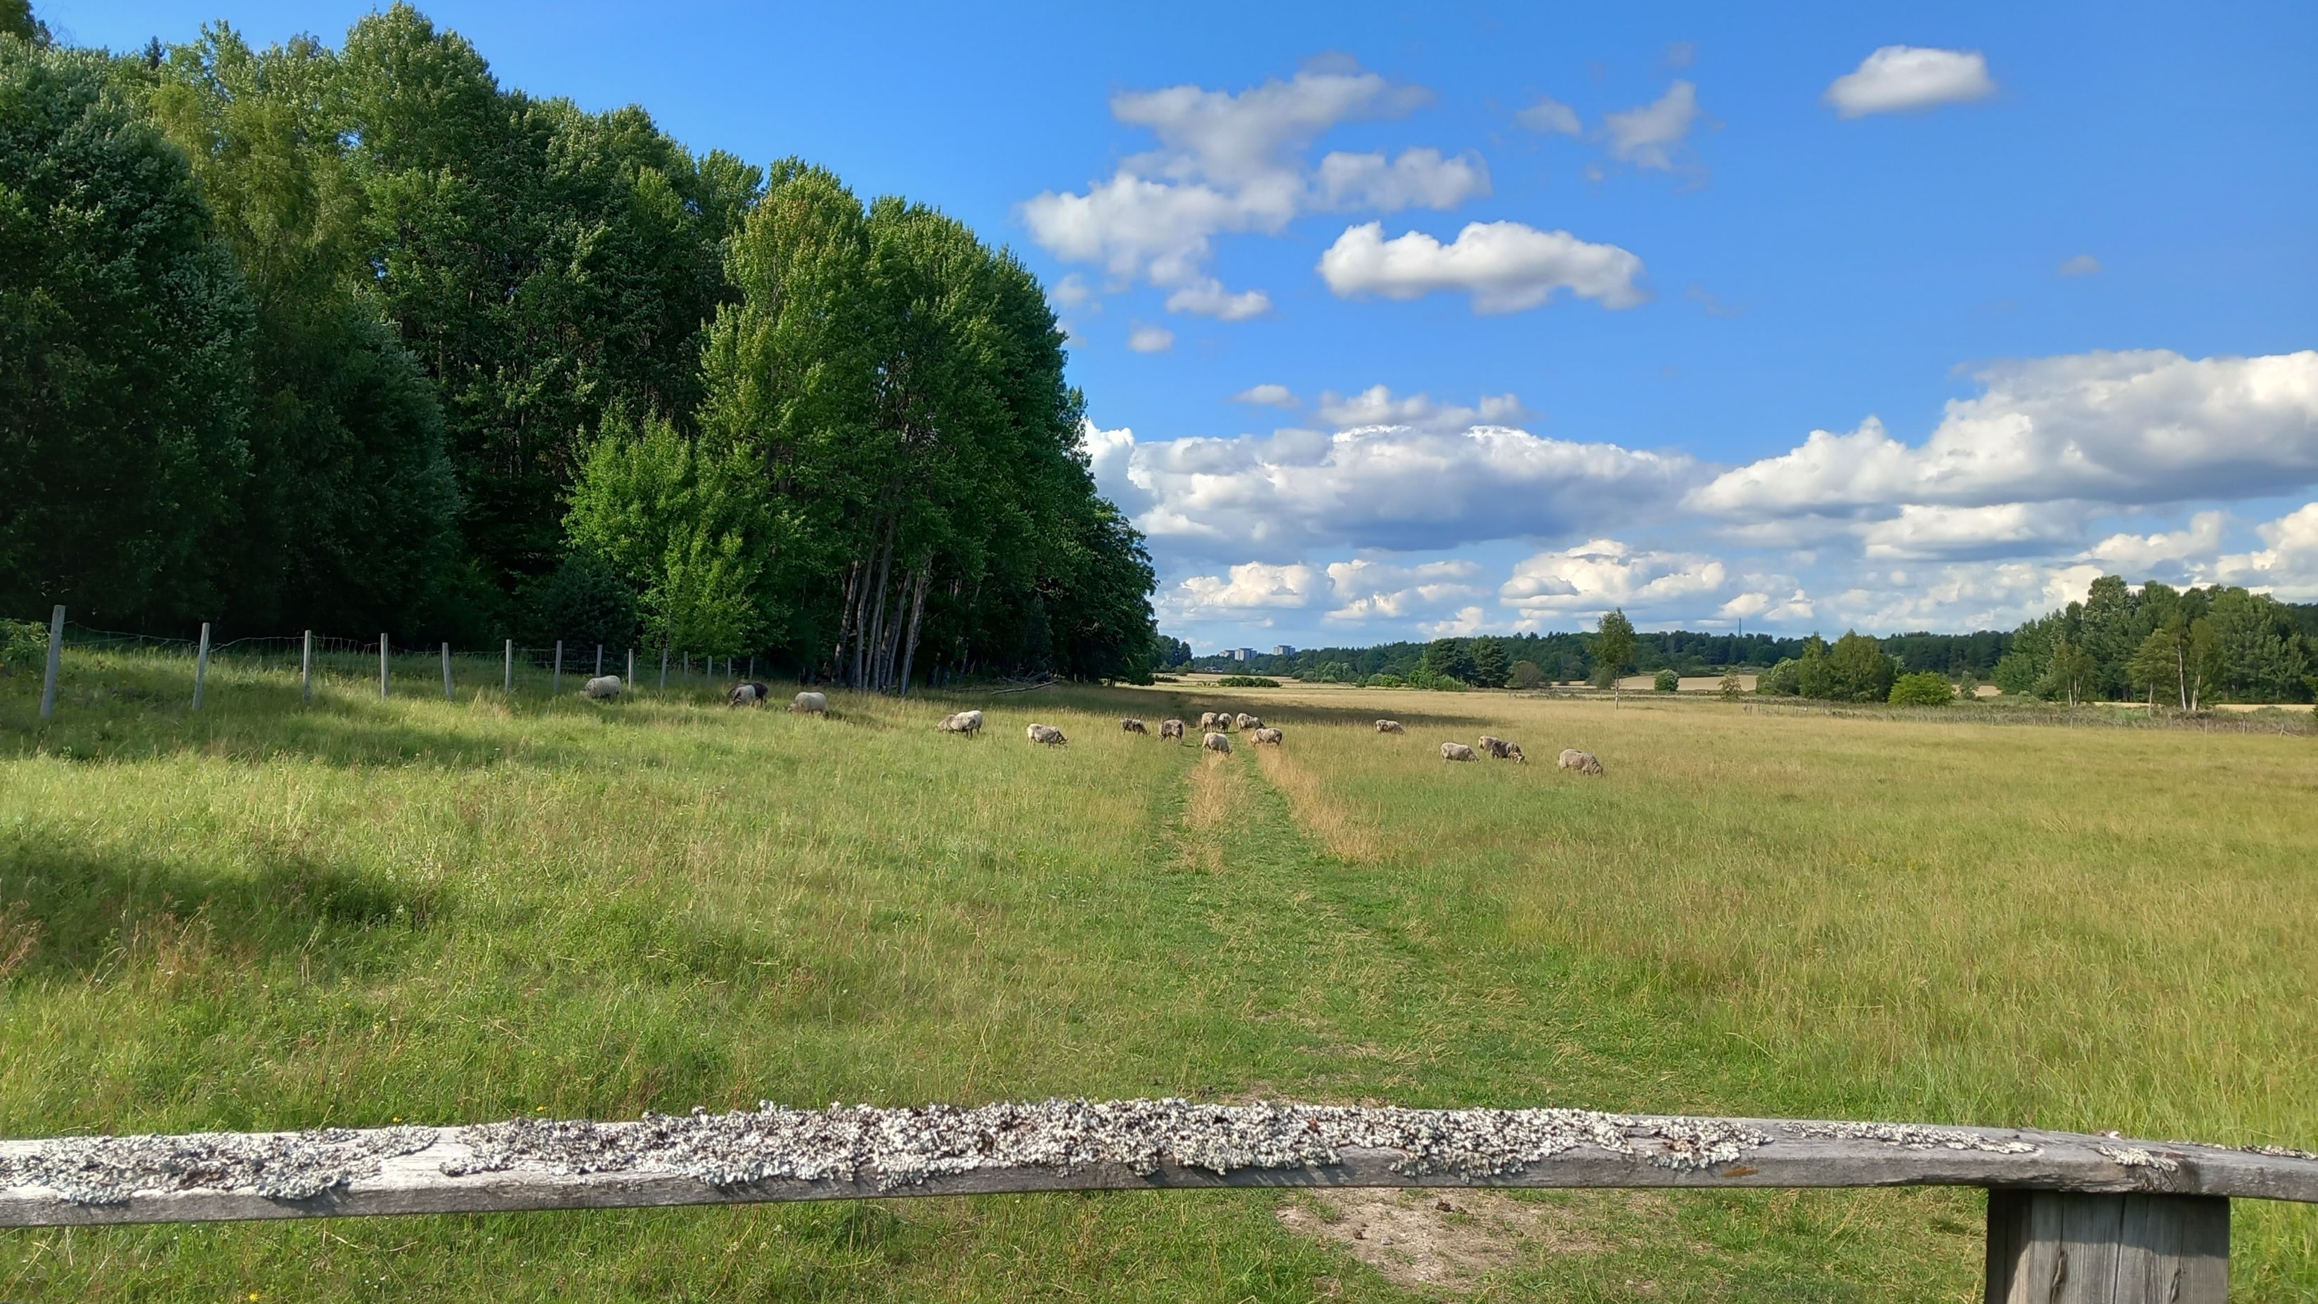

Slide 20
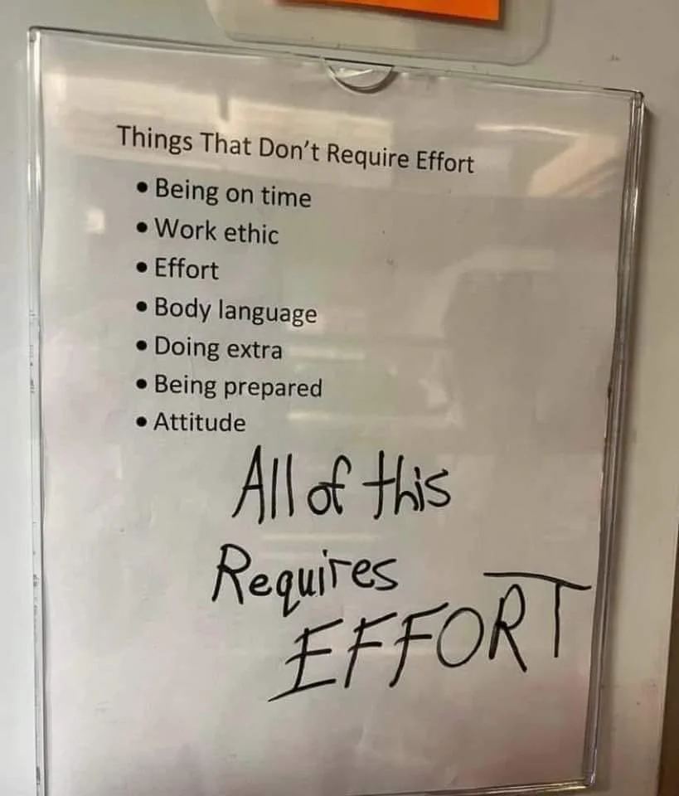
not just ”science done right”
not cheap
won’t solve other problems
Notes:
My point is that open science shapes and limits what research we can do. It's not a content-independent framework -- "just science done right" -- but affects what kinds of knowledge we produce.
If we do it seriously, it takes resources, knowledge and time. There are substantial costs and opportunity costs. That doesn't mean it's not worthwhile -- arguably, nothing worthwhile is cheap -- but it's not a "you just have to ..." People won't "just" do anything.
Other bad things, treadmill, horrible job market, grant lottery, humiliating peer review, won't change unless they are targeted by reform, have little to do with openness.
Stodgy prose, people write data in singular.

Slide 21
Incremental science is good, actually
Excellence is breathlessness
No more rock stars
Notes:
Too much to hope for
Incremental science – you build on something, let others build, one step at a time
Excellent science is not incremental enough, we see this when someone has done a bunch of fraud, and only their coauthors and students are really effect
We all have to worship at the altar of excellence, but we can hope that with openness, the “excellent” people won’t be able to monopolize things as much
If we do it poorly, the cost of openness will just be another tool to keep the lower-resource actors out

Slide 22
“I’m sad when people say theory is expensive, difficult to fund inherently, requires much data, or something else misguided.”
“I sat in a room alone for a year crying, reading, and writing CHEAP AF”
Olivia Guest
Notes:
There is low resource science that need to be done
Lot of theory

Slide 23
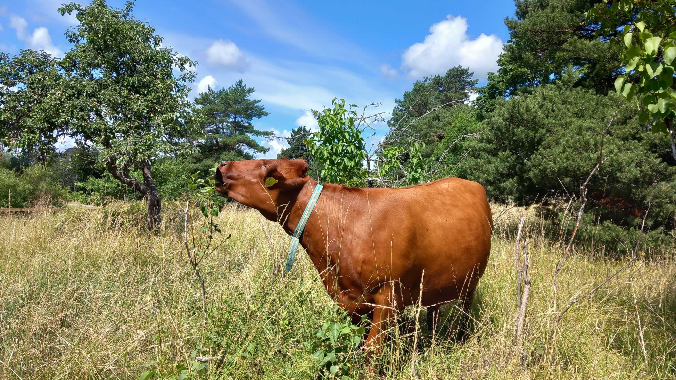

Slide 24

? ! @
Incremental science is good, actually
Excellence is breathlessness
No more rock stars
Martin.Johnsson@slu.se
@mrtnj@mastodon.social

Slide 25
UNESCO pillars of open science, https://en.wikipedia.org/wiki/Open_science#/media/File:UNESCO-Open_science-pillars-en.png https://creativecommons.org/licenses/by-sa/4.0
Devezer Berna, Navarro Danielle J., Vandekerckhove Joachim and Ozge Buzbas Erkan 2021 The case for formal methodology in scientific reformR. Soc. open sci.8200805200805 http://doi.org/10.1098/rsos.200805
Zhang, S., Roller, S., Goyal, N., Artetxe, M., Chen, M., Chen, S., Dewan, C., Diab, M., Li, X., Lin, X.V., Mihaylov, T., Ott, M., Shleifer, S., Shuster, K., Simig, D., Koura, P.S., Sridhar, A., Wang, T., Zettlemoyer, L., 2022. OPT: Open Pre-trained Transformer Language Models. https://arxiv.org/abs/2205.01068
https://www.technologyreview.com/2020/11/12/1011944/artificial-intelligence-replication-crisis-science-big-tech-google-deepmind-facebook-openai/ Accessed 2023-02-23

